Slide 1

Vehicle Speed Estimation from Single Camera Video Feeds in Unconstrained Environments
Graduation Project Defense
Author: Hector Mejia Vallejo

Slide 2
Outline
Problem
Problem Statement
Proposed Solution
Methodology
Proposed Framework
Data Gathering
Data Preparation
Homography Estimation
YOLOv4 Object Detection
Object Tracking
Results
Graphical User Interface
Homography Estimation
Distribution of Speeds on Virtual Line
Distribution of Speeds on all RoI
Length of the Tracks
Speed of Individual Vehicles
Conclusions
Questions

Slide 3
Problem
1

Slide 4
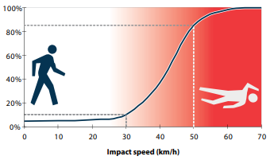
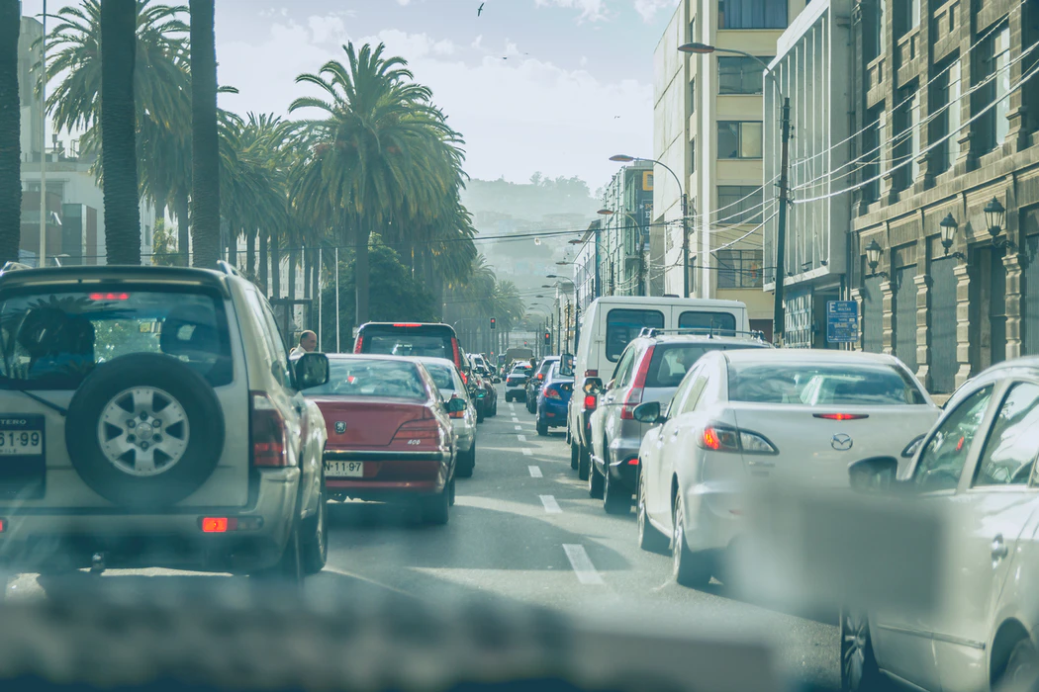
Problem Statement
Fatalities and property damage
Environmental and economical consequences derived from traffic congestion

Slide 5
Proposed Solution
Harness Already existing infrastructure.
Speed Estimation System using single camera feed only.
Three Components:
Homography
Detection
Tracking

Slide 6
Methodology
2

Slide 7
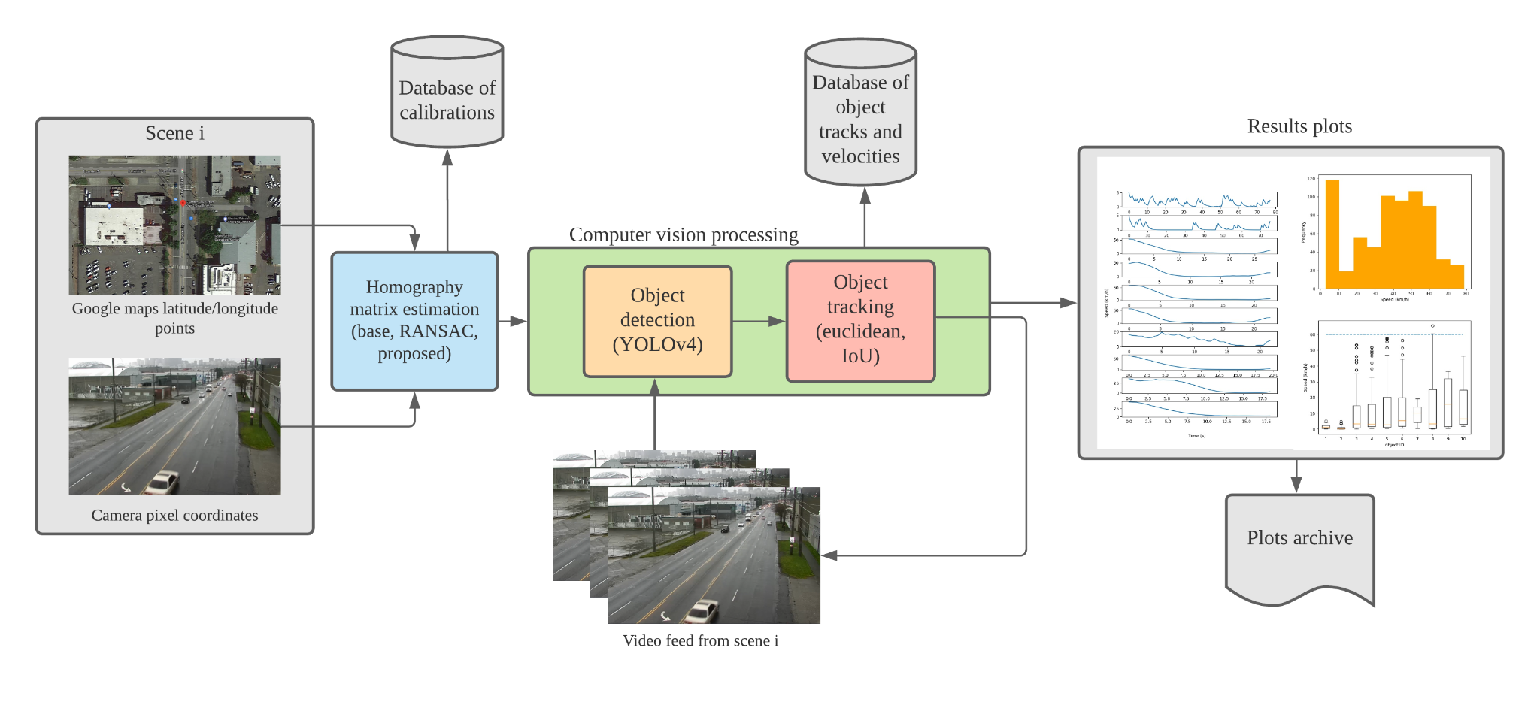
Proposed Framework

Slide 8
Data Gathering
14 videos recorded from Seattle U.S.A department of transportation webpage
10 videos were usable.
4 videos corrupted.

Slide 9
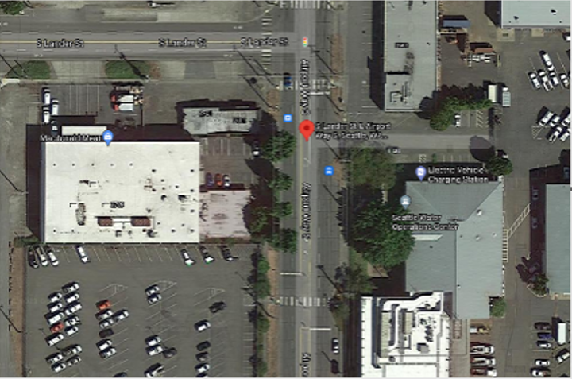
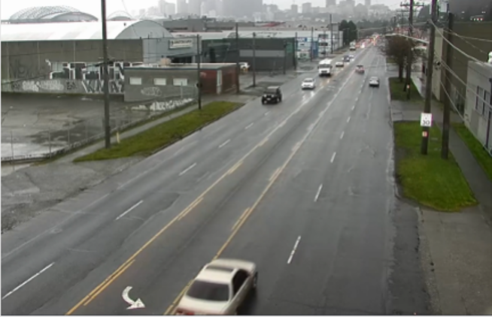
Data Preparation
Manual Selection of Longitude-Latitude coordinates of Google Maps
Manual selection of image coordinates of the scene on the video

Slide 10
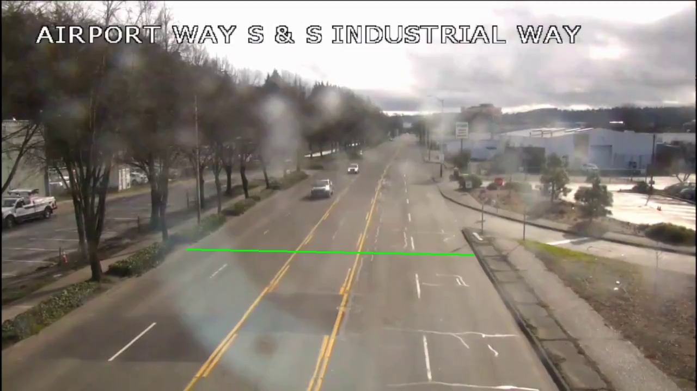
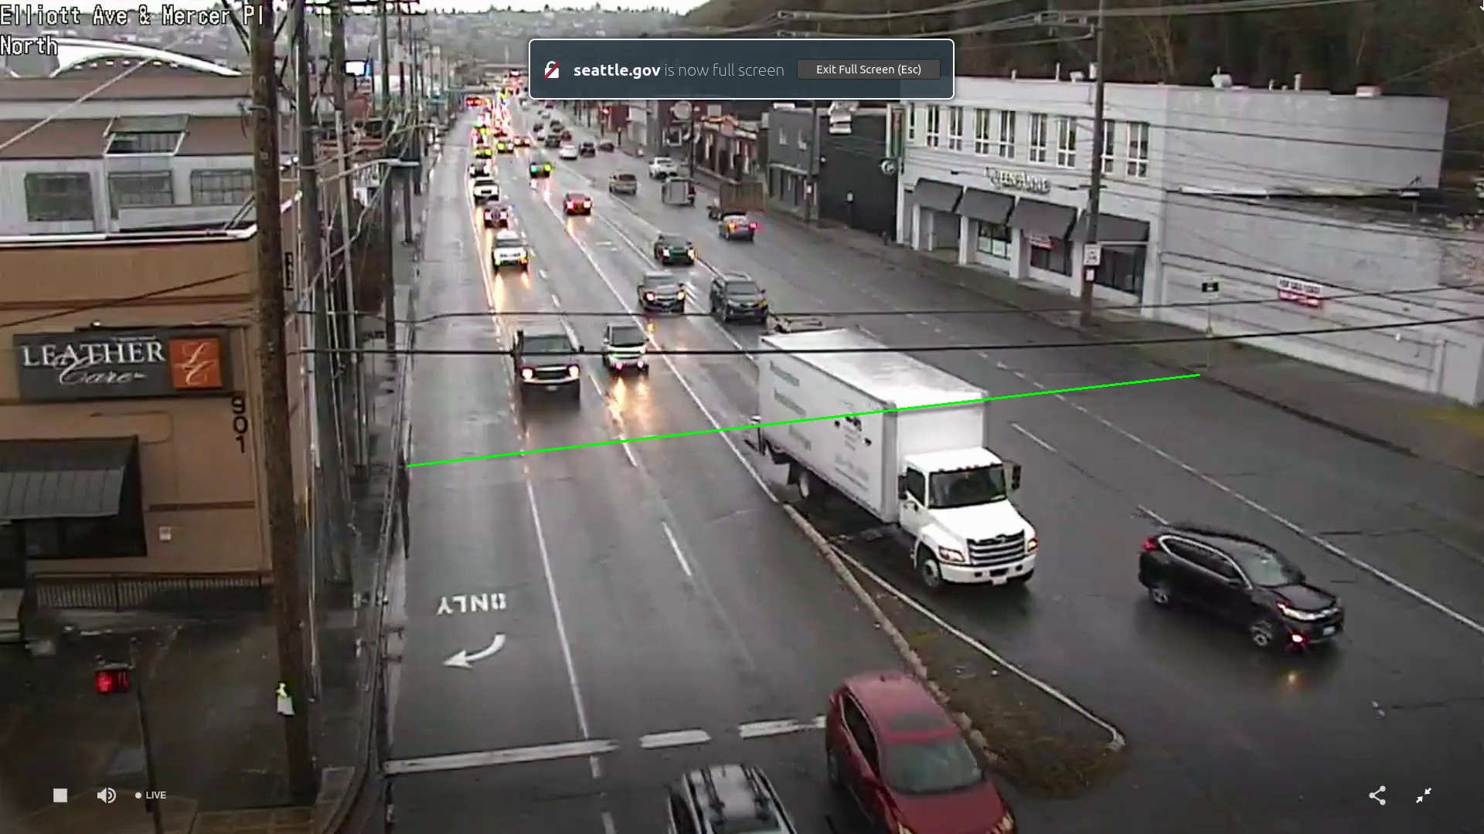
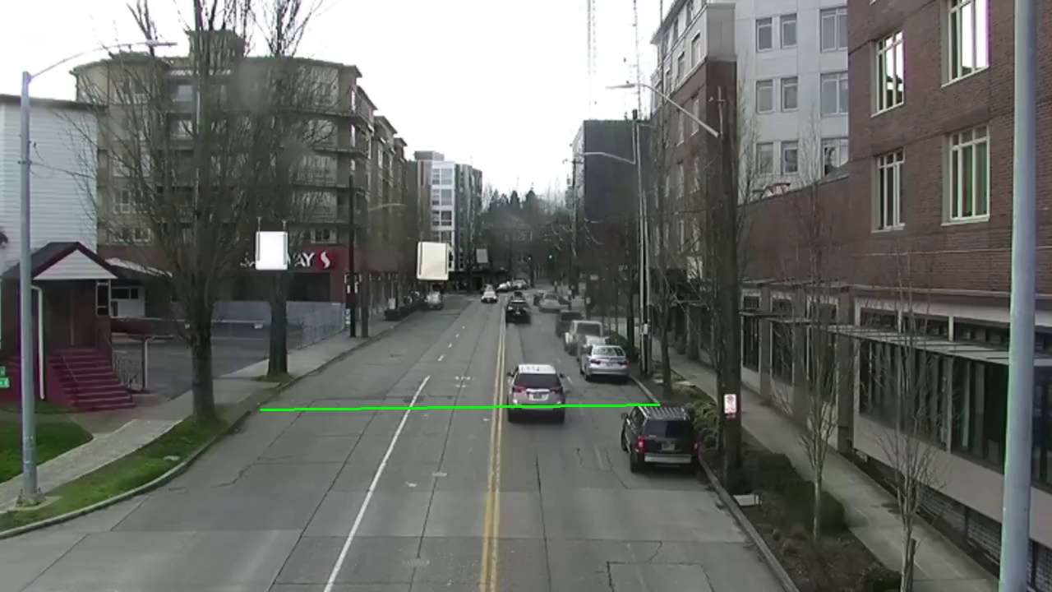
Data Preparation
Definition of a virtual line as a speed recording trigger

Slide 11
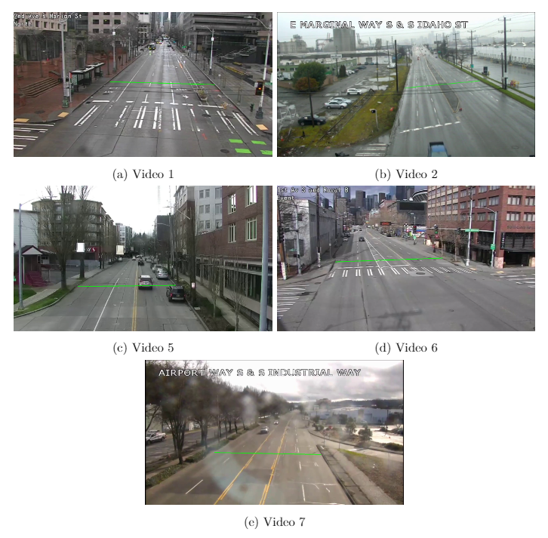
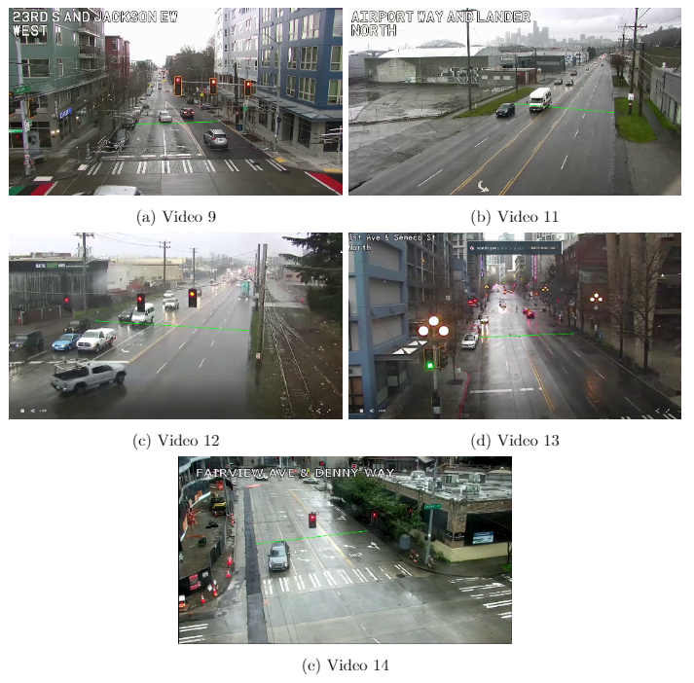
Data Preparation

Slide 12
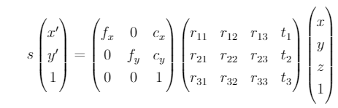
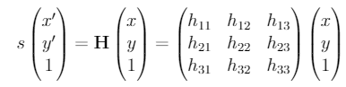
Homography Estimation
Flat Road
Solve using DLT

Slide 13
Homography Estimation
Approaches:
Basic DLT
Random Sample Consensus (RANSAC)
Proposed methodology (EDA evolutionary)

Slide 14
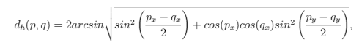
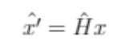
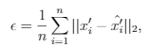
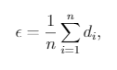
Homography Estimation
Step | Projection Error | Distance Error
1
2

Slide 15
YOLOv4 Object Detection
Architecture design
Feature extraction backbone (CSPDarknet-53)
Upsampling and downsampling paths
Detection heads

Slide 16
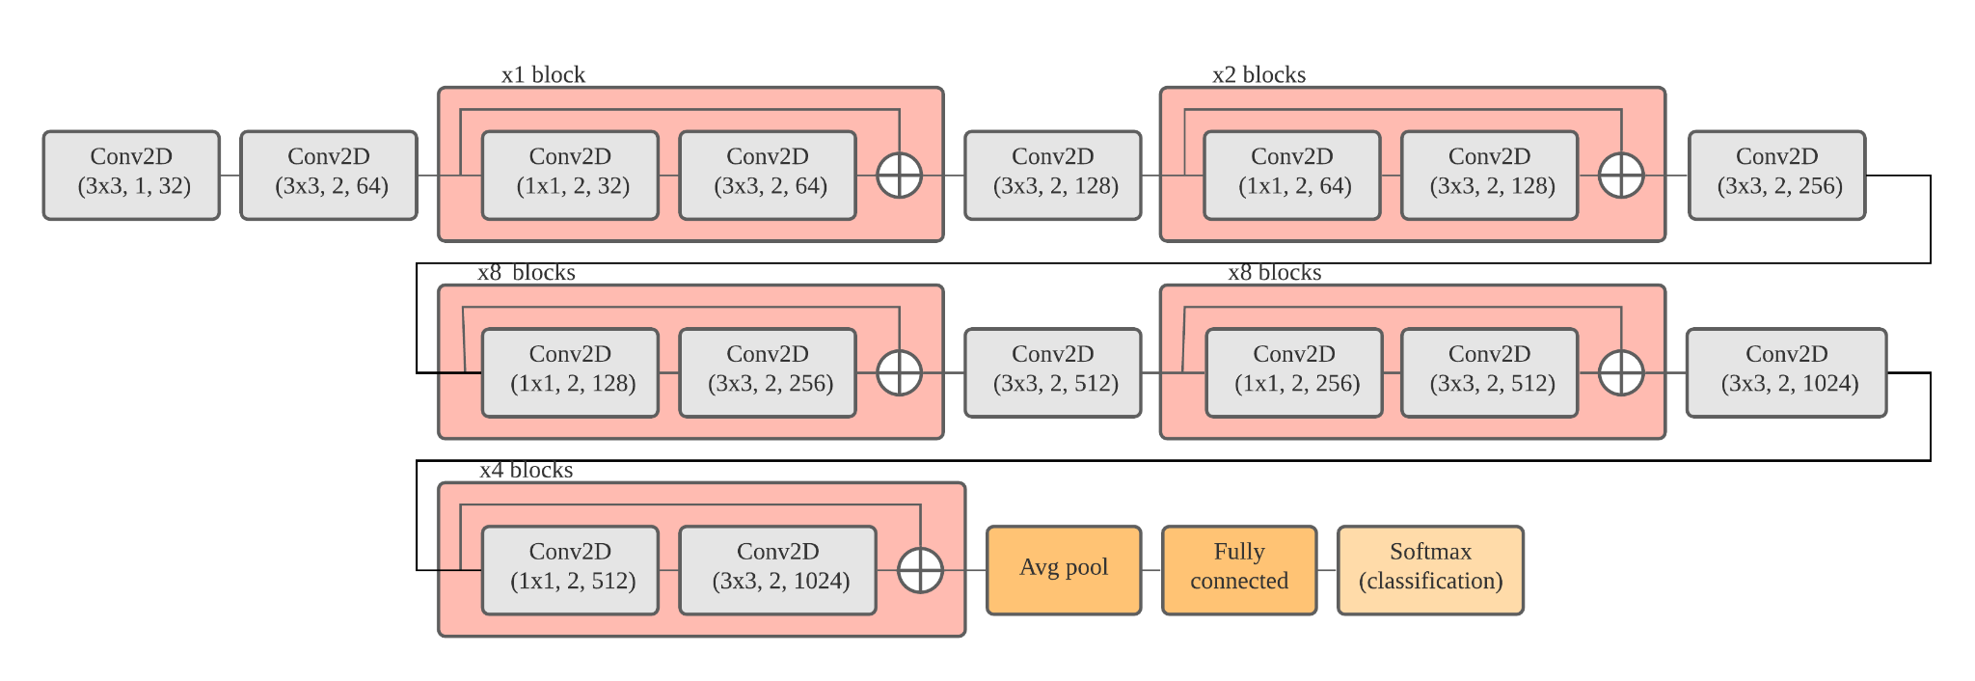
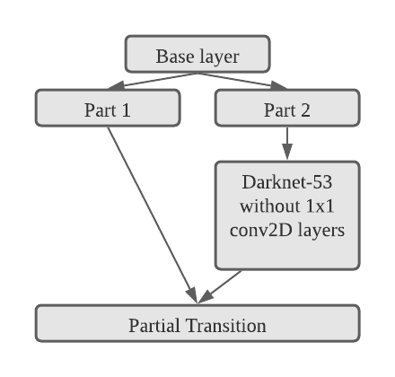
YOLOv4 Object Detection
Backbone of detector (feature extractor)
Each red block in (1) is split into two parts, to produce (2)
DarkNet 53 original (1)
CSPDarkNet-53 block (2)

Slide 17
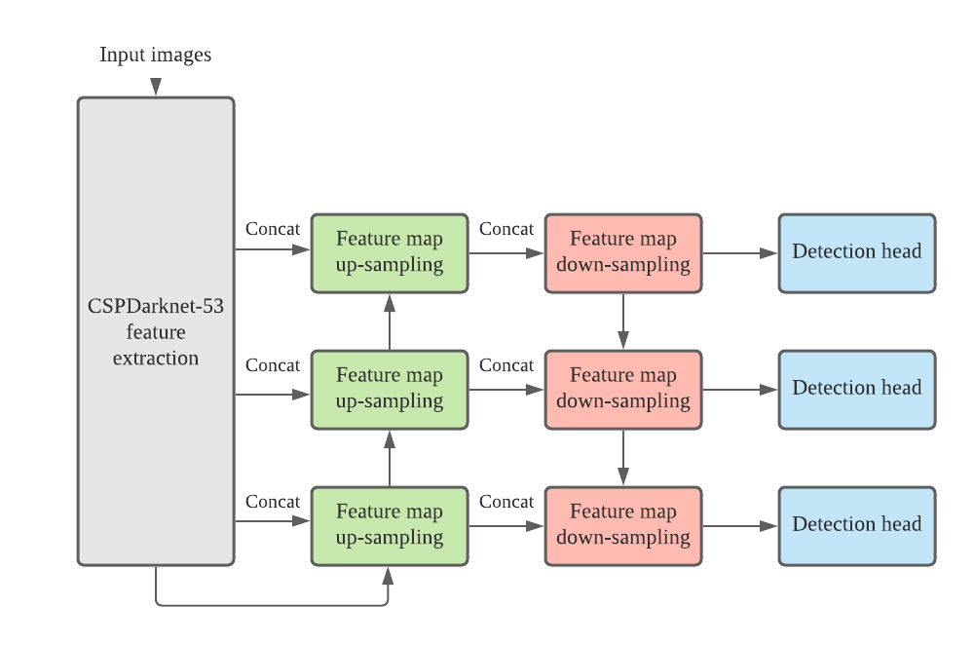
YOLOv4 Object Detection
Detector head

Slide 18
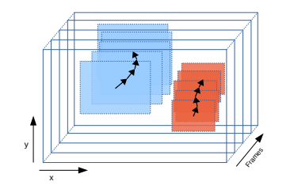
Object Tracking
Two implementations
Euclidean
Intersection over Union (IoU)
The tracker assign ids to detections
The tracker also estimates speed for each vehicle id
Distance traveled every half a second (25 frames)

Slide 19
Results
3

Slide 20
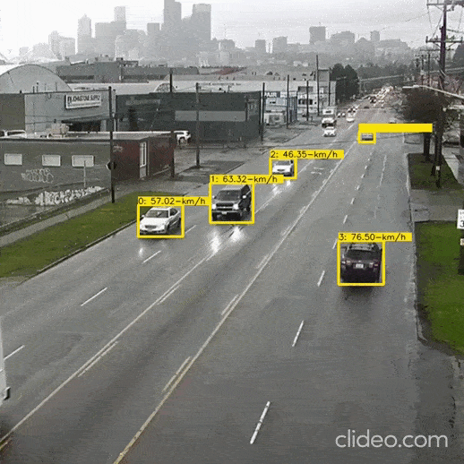
Animation

Slide 21
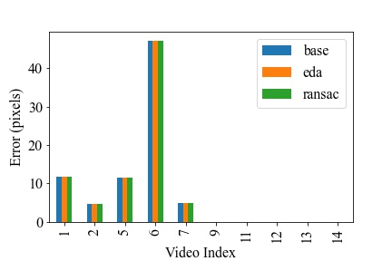
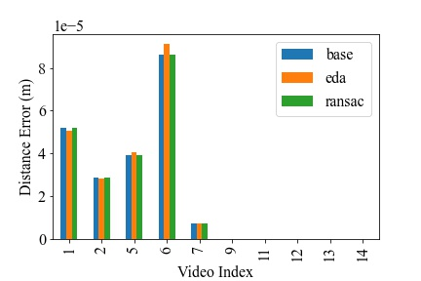
Homography Estimation
Projection Error
Distance Error

Slide 22
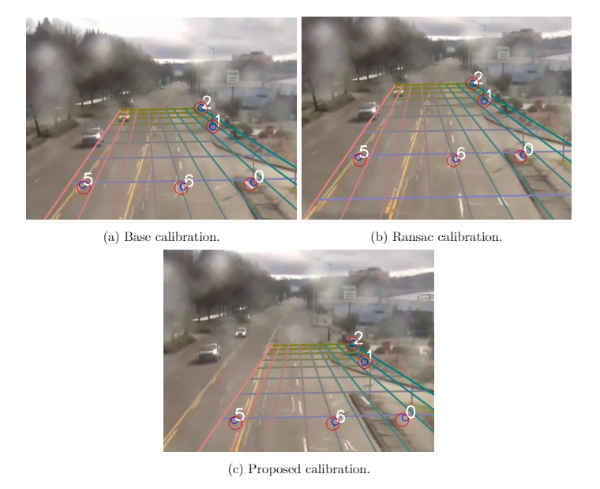
Homography Estimation
Red circumferences: estimates
Blue circumferences: truths
Grid: Model of the street

Slide 23
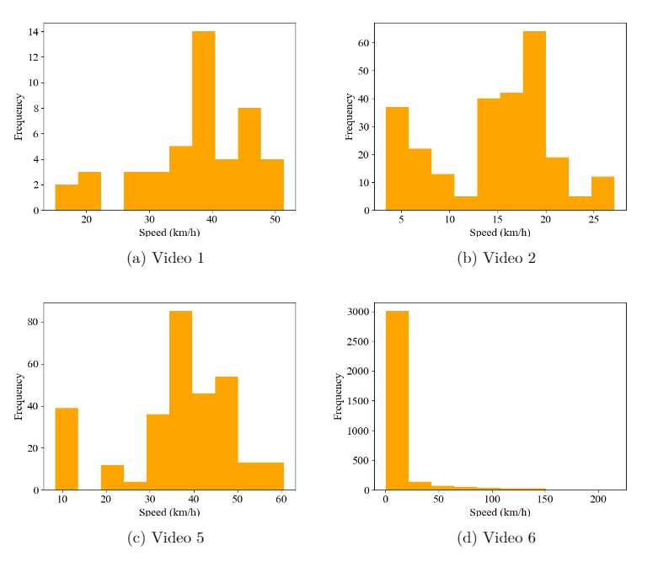
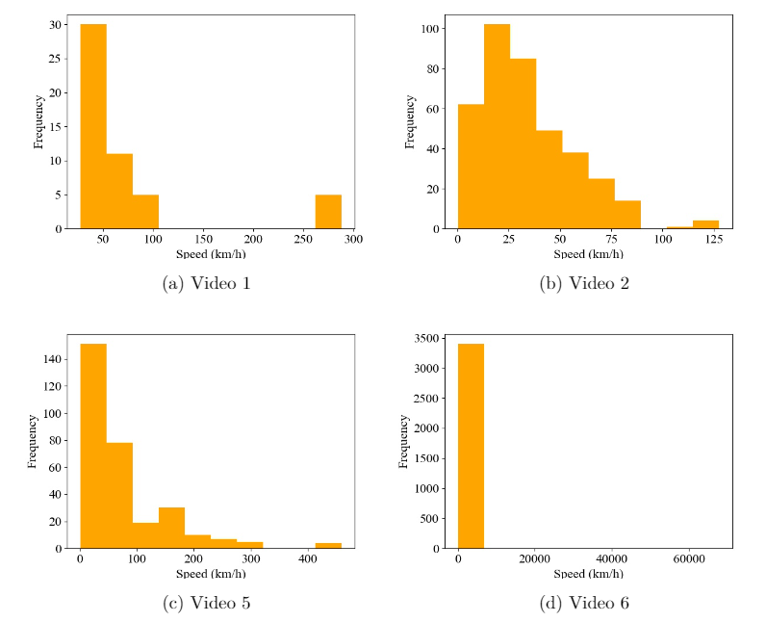
Distribution of Speeds on Virtual Line
IoU
Euclidean

Slide 24
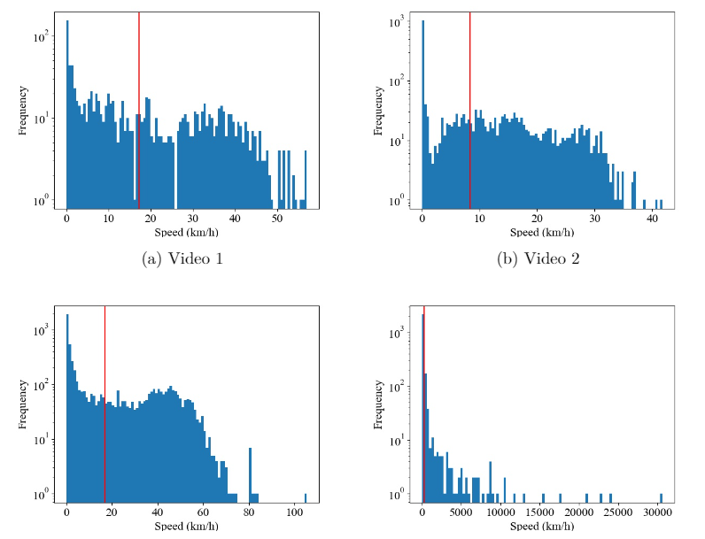
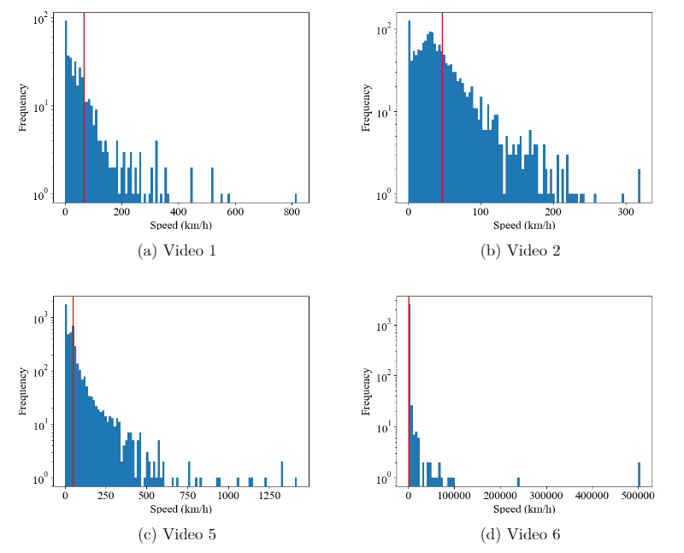
Distribution of Speeds on All RoI
IoU
Euclidean

Slide 25
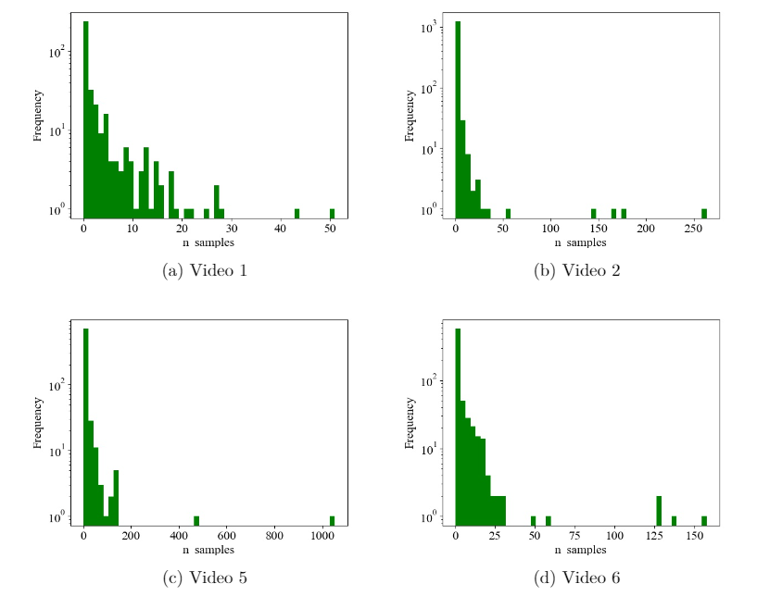
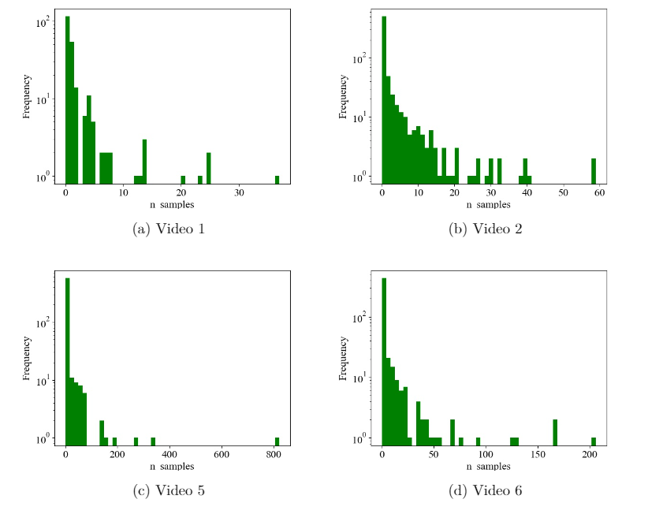
Length of the Tracks
IoU
Euclidean

Slide 26
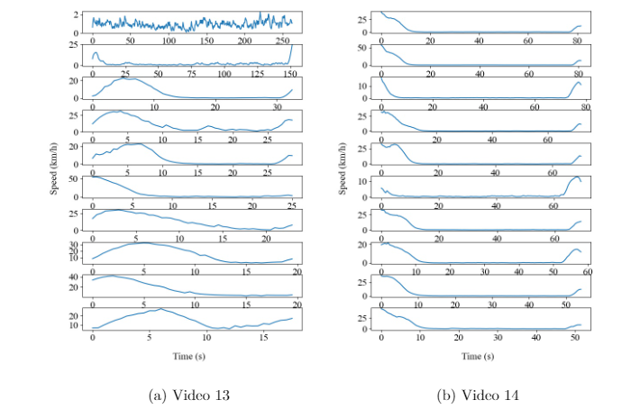
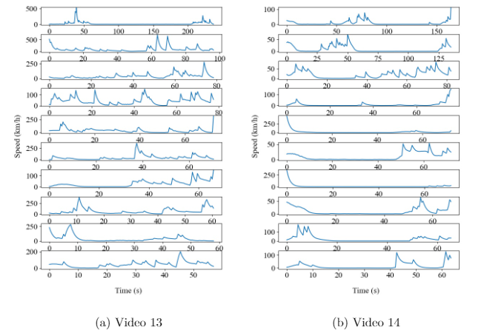
Speed of Individual Vehicles
IoU
Euclidean

Slide 27
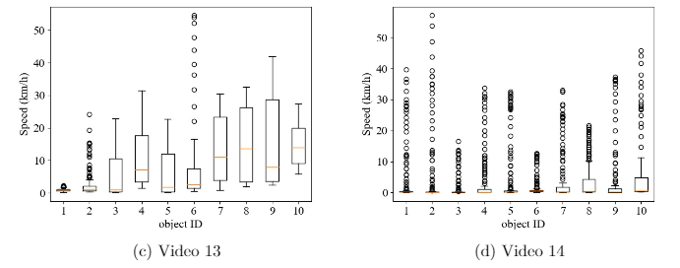
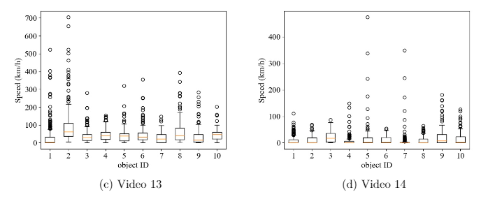
Speed of Individual Vehicles
IoU
Euclidean

Slide 28
Conclusions
4

Slide 29
Conclusion
All three homography methods have similar performance
Detector performed reliably, but missed vehicles when occlusions occur.
IoU tracker was the best implementation
IoU tracker had distribution of speeds within the range of urban traffic speed

Slide 30
Thank you!
I would like my degree now, please

